Slide 1

Speedup VS Efficiency in Parallel Systems
By Amir Elmahalawy
YWCC 307

Slide 2
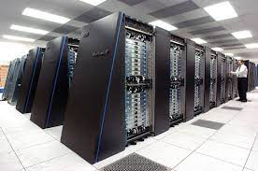
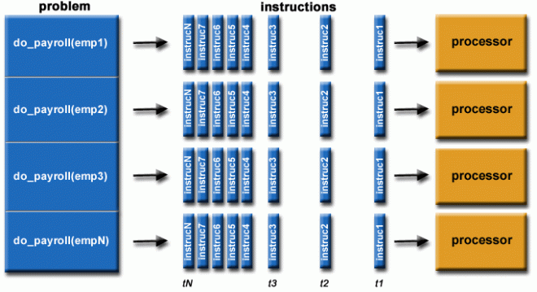
Parallel Systems
A parallel system consists of an algorithm and the architecture that the algorithm is implemented.

Slide 3
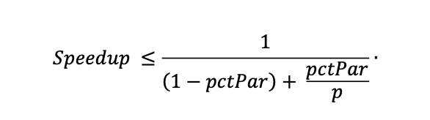
Speedup in Parallel Systems
The ratio of the time required by the best sequential algorithm to get a practical to solve a problem, to the time required by parallel algorithm using p processors to solve the same problem
It is defined by the Amdahl’s formula:
pctPar -- Parallel Execution
p – Amount of Processing Cores
(1 -- pctPar) – Serial Execution Time

Slide 4
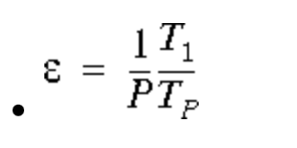
Efficiency in Parallel Systems
Efficiency is the proportion of simultaneously available resources utilized by a computation.
High-Powered Computers (HPC) Usually aim for the highest possible efficiency.
It is defined by this formula:
P -- # of Processors
T₁ – Time for optimal serial algorithm on one processor
T_{p} – Time for parallel algorithm on P processors

Slide 5
Performance Metrices for Parallel Systems
Run Time:
The parallel run time is the time that elapses from the moment that a parallel computation starts to the moment that the last processor finishes execution.
Serial Run Time: Ts
Parallel Run Time: T_{p}

Slide 6
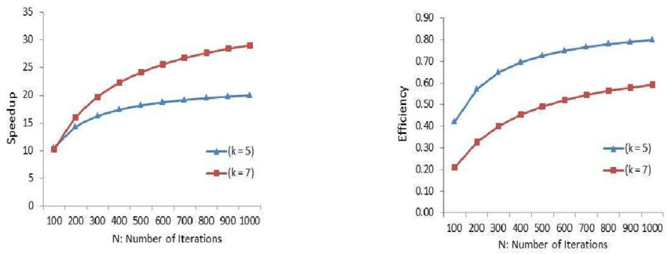

Slide 7
References
https://www.bu.edu/tech/support/research/training-consulting/online-tutorials/matlab-pct/scalability/
https://ieeexplore.ieee.org/stamp/stamp.jsp?arnumber=21127
https://www.stolaf.edu/people/rab/pdc/text/alg.htm

